Slide 1
System Architecture for Virtual Payment Platform
By Neba eric suh

Slide 2
Project Overview
The platform aims to process virtual payments by providing virtual cards to users through web and mobile applications.
The system integrates multiple modules and third-party services to ensure scalability, reliability, and real-time transactions.

Slide 3
Objectives
• Build a secure and scalable payment platform.
• Provide users with virtual card functionalities.
• Enable real-time transactions using Redis caching.
• Integrate third-party wallet and card APIs.
• Offer mobile and web accessibility.

Slide 4
System Modules
1. Authentication & User Management
2. Virtual Card API Integration
3. Transaction-Based System using Redis
4. Wallet Management (Third-Party Integration)
5. Monitoring and Security Layer

Slide 5
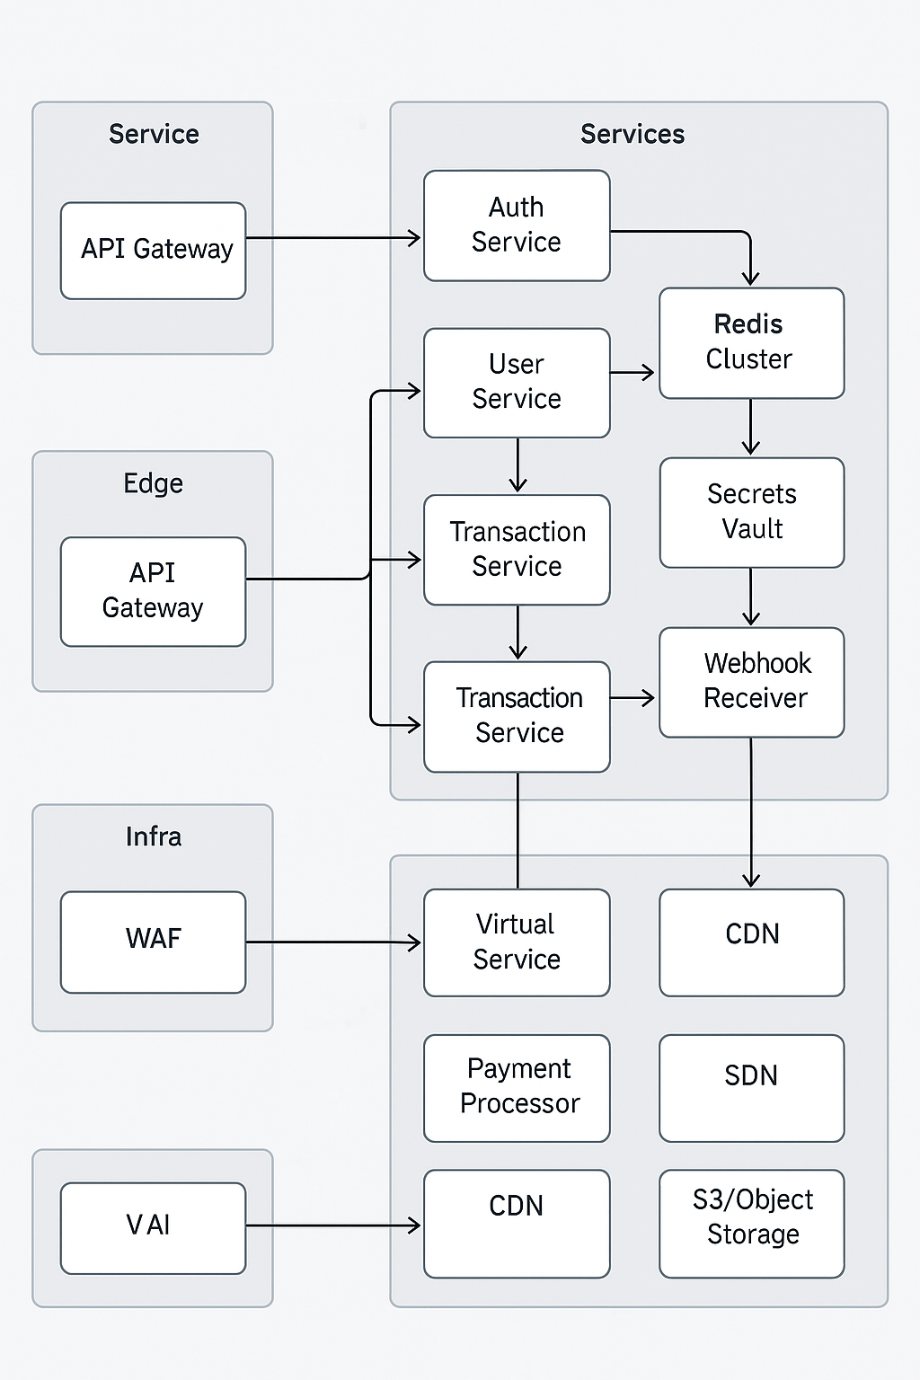
System Architecture Overview
This diagram illustrates the high-level
system components and interactions
the infrastructure, services, and edge
layers.

Slide 6
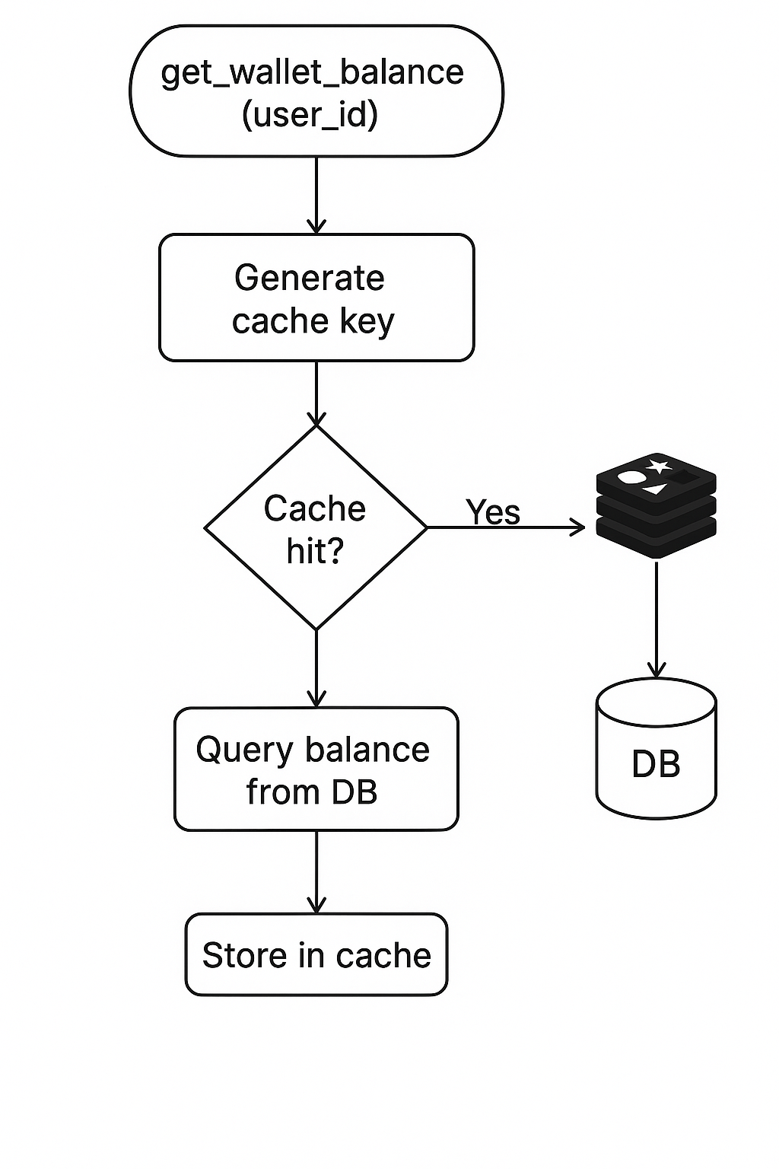
Wallet Balance Retrieval Process
This flow diagram demonstrates how
wallet balance requests are processed
efficiently using caching for better performance.

Slide 7
Authentication & User Management
• Handles user registration, login, and session management.
• Integrates OAuth2 and JWT for secure token-based authentication.
• Manages user roles and permissions for access control.

Slide 8
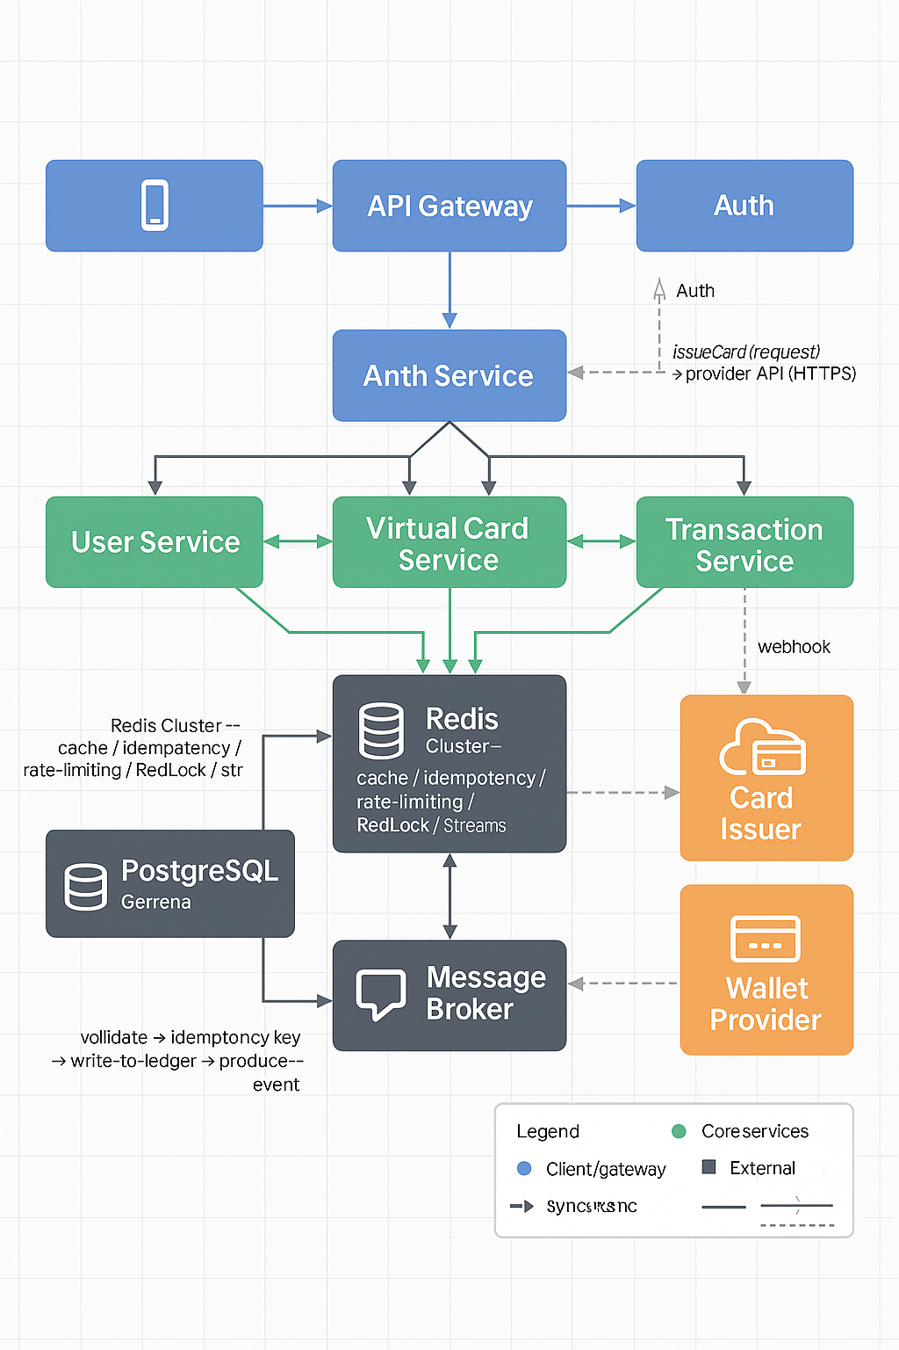
Application System Architecture

Slide 9
Virtual Card & Wallet System
• Virtual cards are provisioned via a third-party API.
• Wallet services interact with external providers for top-ups and withdrawals.
• Real-time balance synchronization through Redis caching.

Slide 10
Transaction System using Redis
• Redis enables fast caching and queuing of transactions.
• Reduces database load and improves latency.
• Ensures real-time balance and transaction updates.

Slide 11
Summary & Future Enhancements
The platform successfully integrates secure authentication, real-time transaction handling, and scalable architecture.
Future goals:
• Expand to multi-currency support.
• Integrate AI-based fraud detection.
• Improve analytics dashboards for admins.

